Slide 1
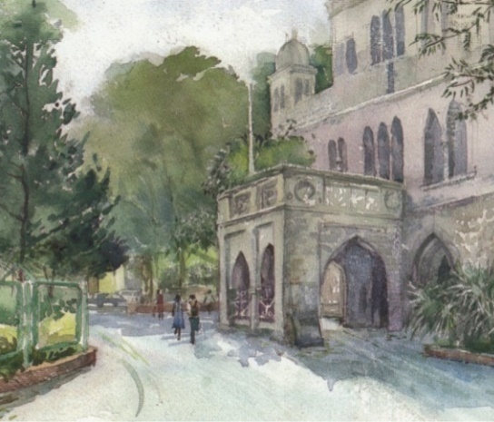


Biology for Engineers (BFE)
NEP Complied Syllabus
APPLICATION AREAS IN BIOENGINEERING
----------------------------------------------
UNIT 5
Databases & Biocomputing: Acquisition, storage, processing and transmission of biological data and its applications like PCR
Bioinstrumentation: Diagnostic and Therapeutic devices
Bioimaging: Principle, types and examples,
Biosensors: Principle, types and examples,
Application of Artificial Intelligence in bio-medical field

Slide 2
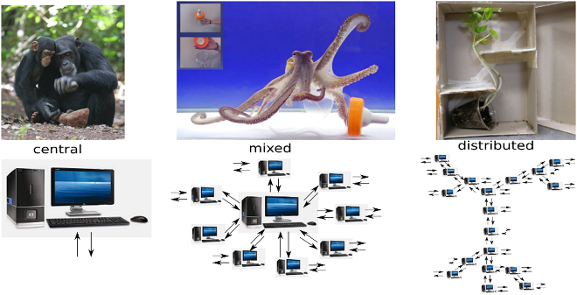
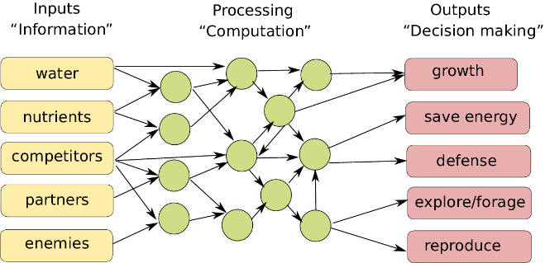
Database & Biocomputing

Slide 3
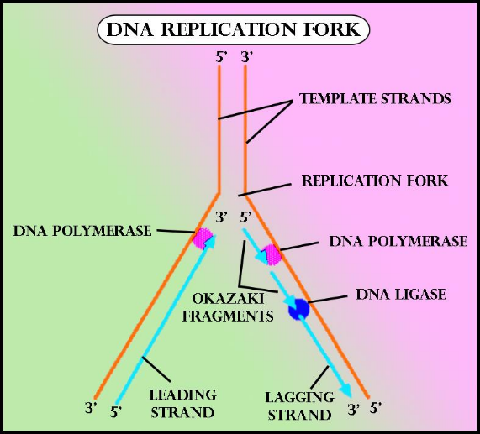
DNA Replication
Enzyme | Role
Helicase | Separation of DNA srands
SSB Proteins | Prevention of recoiling of separated strands
DNA Polymerase III | Continuous synthesis of complementary strand of Leading strand of DNA (3’-5’)
RNA Primase | Synthesis of RNA primer at lagging strand
DNA Polymerase III | Synthesis of Okazaki fragments between two RNA primers
DNA Polymerase I | Editing of RNA primer (replacement of Uracil by Thymine)
DNA ligase | Joining of Okazaki fragments

Slide 4
Central dogma of molecular biology
DNA
mRNA
Protein
Transcription
Translation
Nucleotide
Amino acid sequence
Nucleus
Endoplasmic Reticulum

Slide 5
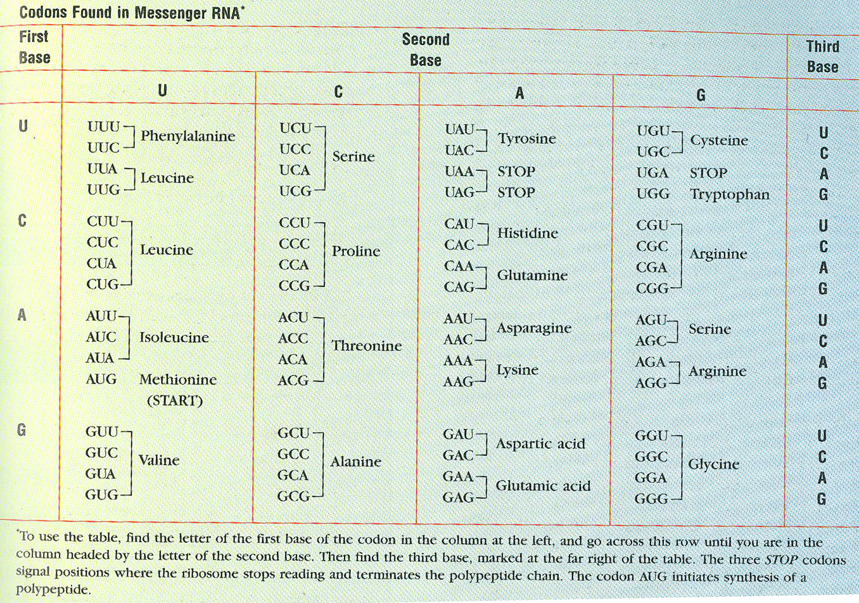

Slide 6
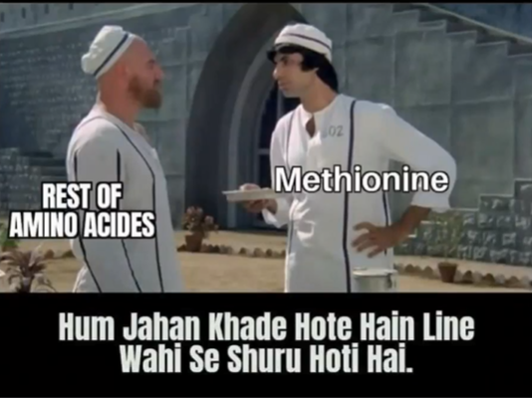

Slide 7
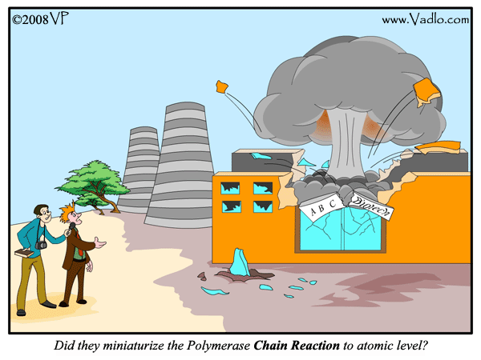
Polymerase Chain Reaction
Powerful method of amplification
In vitro Cloning of DNA
Enzyme: taq polymerase
Oligonucleotide primers
Temperature cycles –
Denaturation (92 degrees)
Annealing (40-60 degrees)
Synthesis (72 degrees)
PCR
Applications of PCR
Large scale amplification
Palaeontological studies
Forensic studies
Pathogens / infections
Human genome project

Slide 8
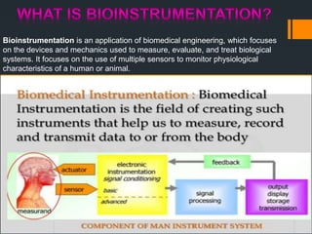

Slide 9
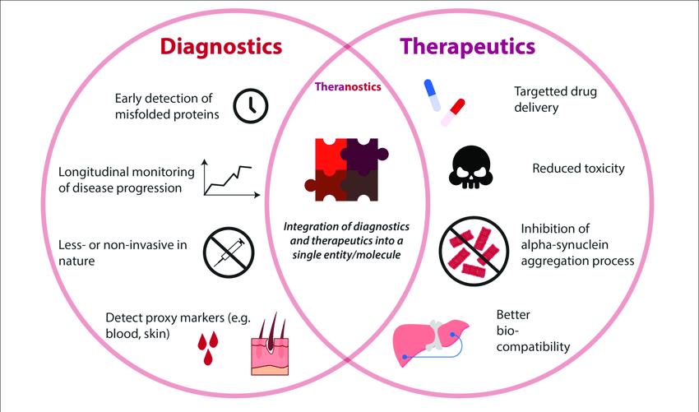
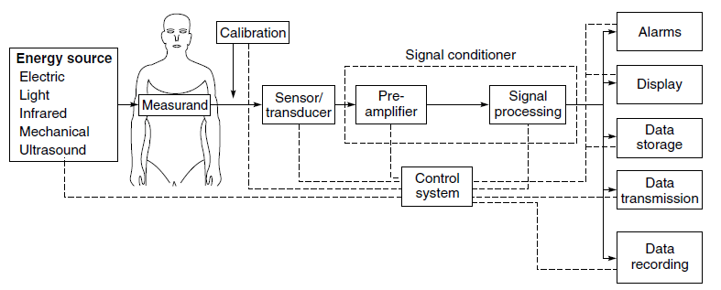
Bioinstrumentation
Block diagram of biomedical instrumentation system

Slide 10
Bioimaging
Bioimaging is the examination of biological structures and function using various qualitative and quantitative techniques.
This science brings together engineers, physicists, biologists and chemists engaged in the development and the methodology for various biological examinations.
Several aspects of bioimaging are confined to research while some have been adapted for live studies i.e. for the detection of biological conditions (diseases and abnormalities) in humans.

Slide 11
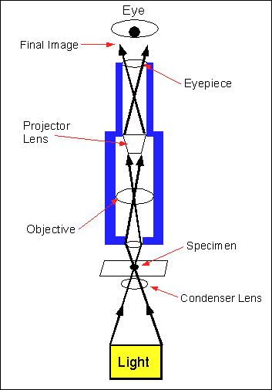
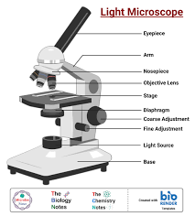
Light Microscope

Slide 12
The term 'fluorescence' was coined by George Gabriel Stokes in his 1852 paper; the name was given as a description of the essence of the mineral fluorite, composed of calcium fluoride, which gave a visible emission when illuminated with "invisible radiation" (UV radiation).
Fluorescence is the emission of visible light by a substance that has absorbed light of a differing, usually invisible, wavelength.
Absorption of a photon triggers the emission of a photon with a longer (less energetic) wavelength.
A shorter wavelength emission is sometimes observed from multiple photon absorption.
The energy difference between the absorbed and emitted photons ends up as molecular rotations, vibrations or heat.
Sometimes the absorbed photon is in the ultraviolet range, and the emitted light is in the visible range, but this depends on the characteristics of the particular fluorescent substance.

Slide 13
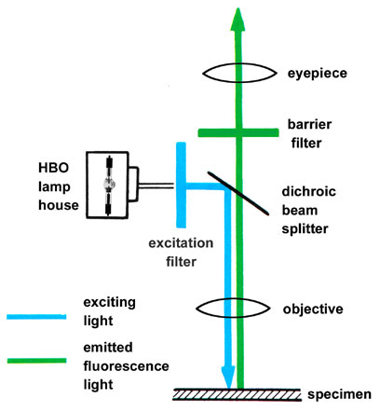
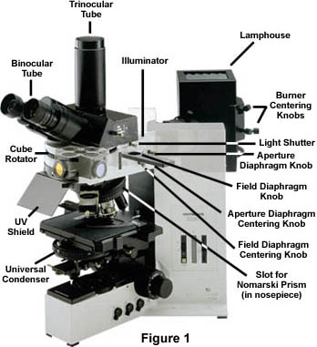
Fluorescence microscope

Slide 15
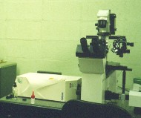
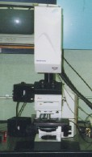
Confocal microscope

Slide 16
How a Confocal Image is Formed
Pinhole 1
Pinhole 2
Specimen
Detector
Condenser
Lens
Objective
Lens

Slide 17
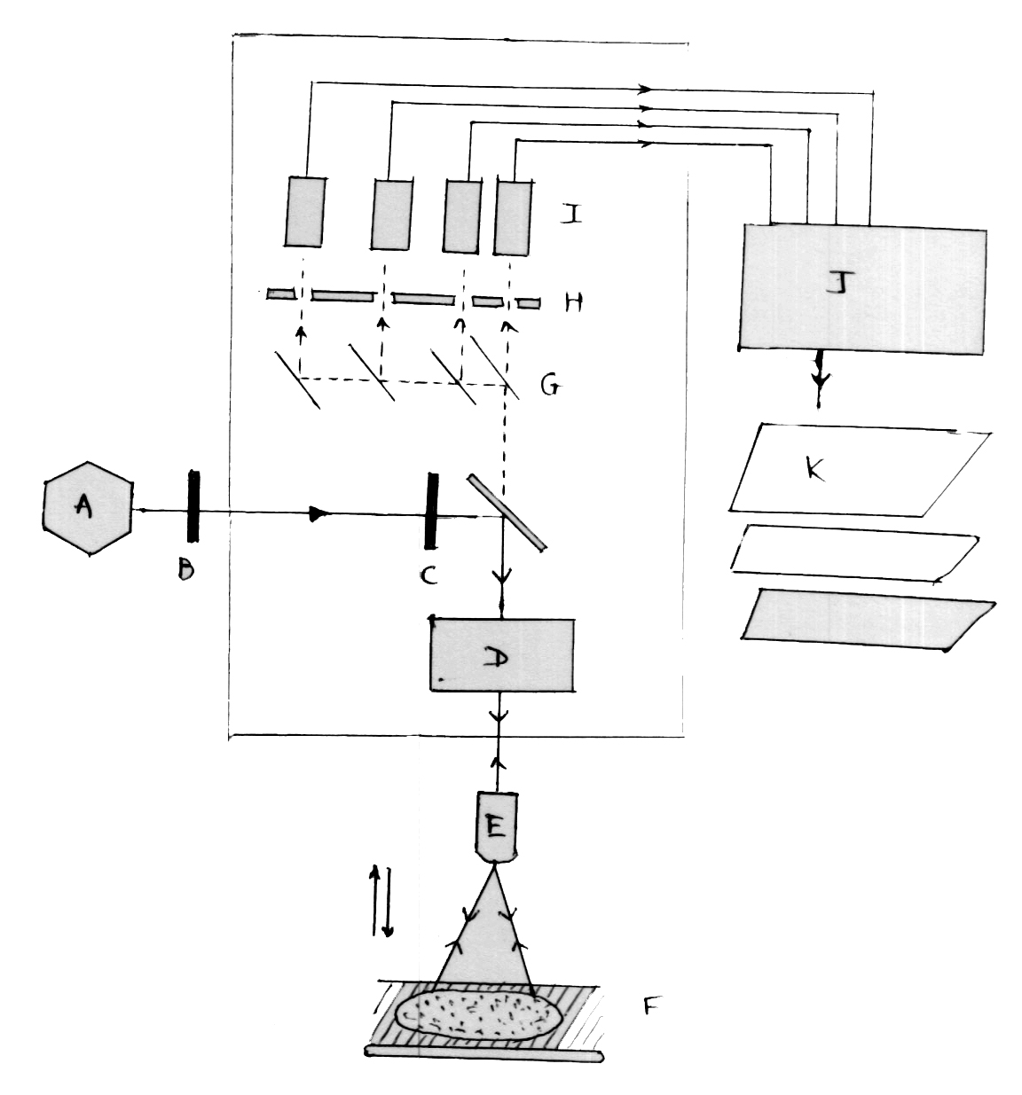
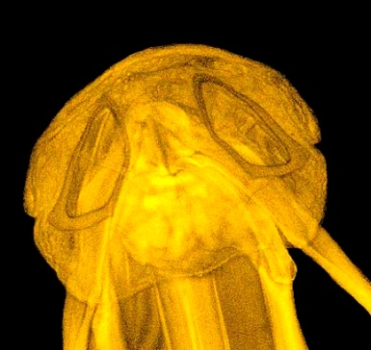
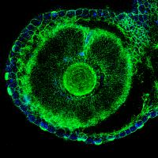
Working of a confocal microscope
A – Laser source
B – Neutral Density Filter
C – Excitation Filter
D – Scanning unit
E – Objective lens
F – Specimen
G – Dichromatic mirrors
H – Pinholes
I – PMT detectors
J – Computer Assistance
K – Image output

Slide 18
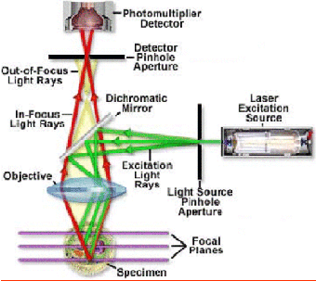

Slide 19
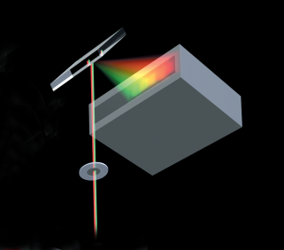

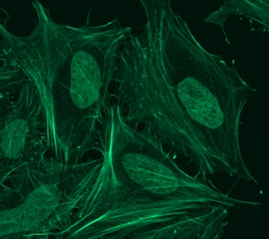
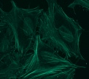
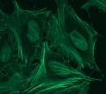
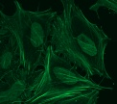
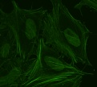
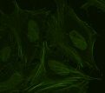
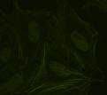
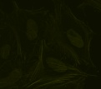
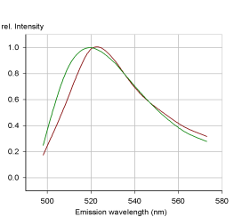
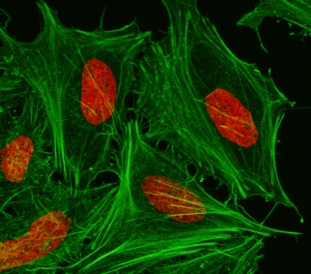
Spectral Unmixing - General Concept
32 Channel Detector
Collect Lambda Stack
Raw Image
FITC
Sytox-green
Derive Emission Fingerprints
Unmixed Image

Slide 20
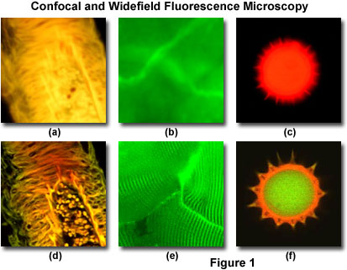

Slide 21
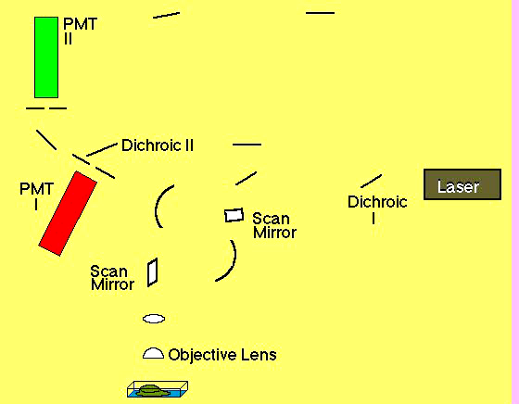
Scanning of 1pt. of excitation lt. across the specimen

Slide 22
Fluorescent Microscope
Confocal Microscope
Arc Lamp
Laser
Excitation Diaphragm
Excitation Pinhole
Excitation Filter
Excitation Filter
Ocular
PMT
Objective
Objective
Emission
Filter
Emission Filter
Emission Pinhole

Slide 23
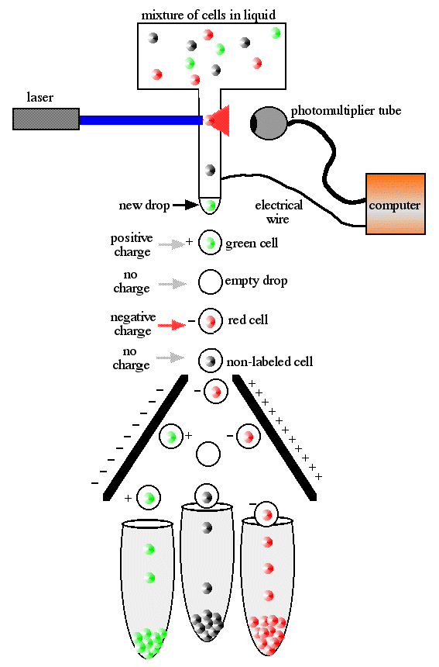
Fluorescence Activated Cell Sorting Machine

Slide 24
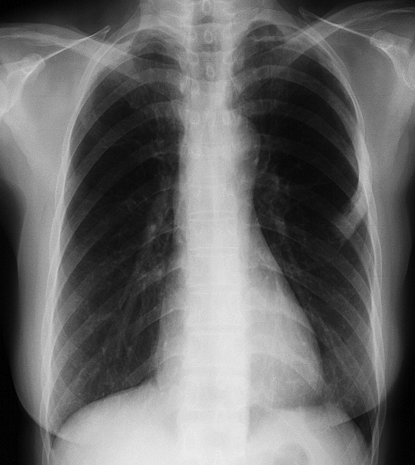
PLAIN X-RAY
MERITS DEMERITS
EASILY AVAILABLE IONISING RADIATION
CHEAP 2-Dimentional
NON-INVASIVE STATIC
FAST
PORTABILITY
EASY TO INTERPETE

Slide 25
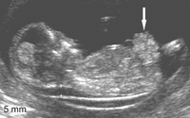
ULTRASONOGRAPHY
MERITS DEMERITS
NON-IONISING OPERATER DEPENDENT
EASILY AVAILABLE GAS ARTIFACTS
CHEAP OBESITY
FAST BONES
DYNAMIC STUDY LOW RESOLUTION
NON-INVASIVE
PORTABLE

Slide 26
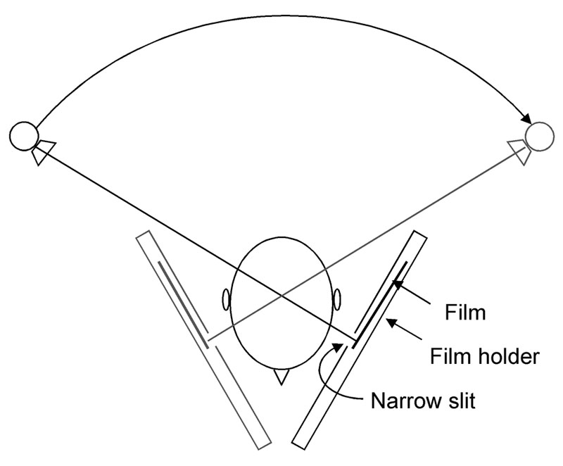
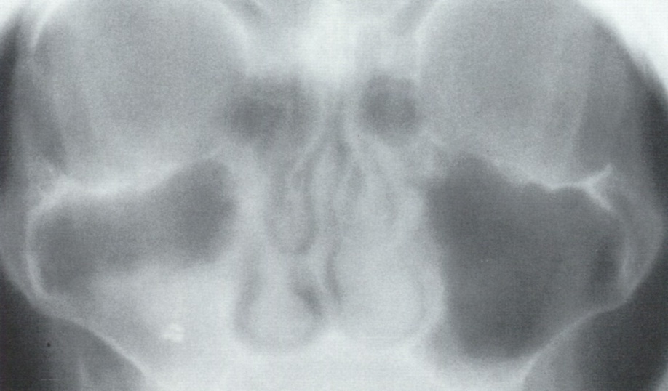
X-RAY TOMOGRAPHY
TOMOS~SECTION, GRAPHY~STUDY
BY MOVING X-RAY TUBE AND FILM, BLURRING OF PLANES OTHER THAN PLANE OF INTEREST

Slide 27
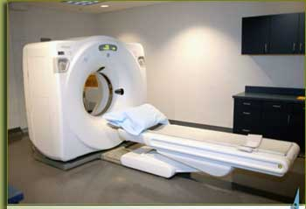
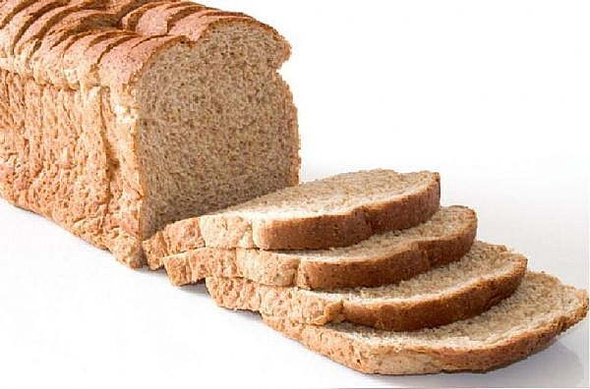
CT Scan Machine
COMPUTED/COMPUTERISED TOMOGRAPHY
1970-HOUNSFIELD AND CORMAC
X-RAY IMAGING TECHNIQUE THAT PRODUCES SECTIONAL VIEWS OF THE PATIENT IN A PLANE PERPENDICULAR TO TABLE TOP ON WHICH PATIENT IS LYING

Slide 28
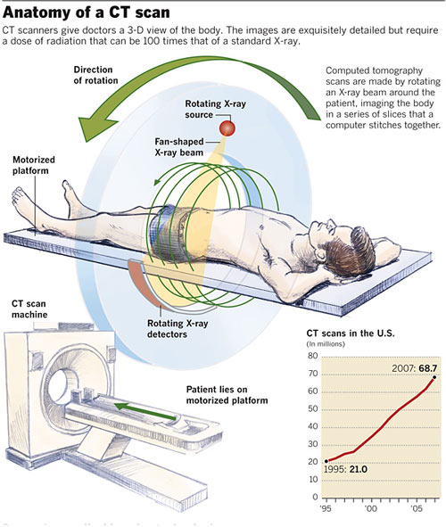
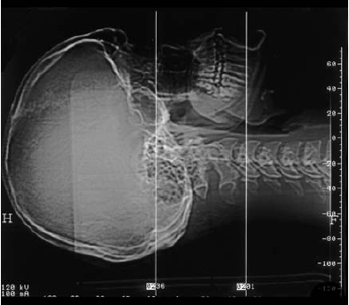
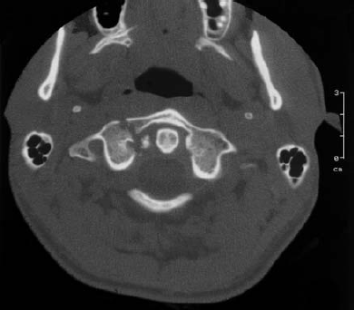
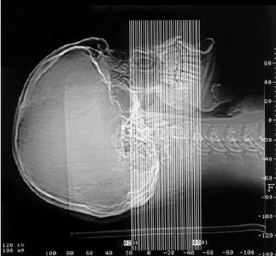

Slide 29
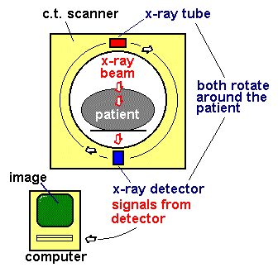
Assembly:
GANTRY
IMAGE PROCESSOR
IMAGE DISPLAY MONITOR
PATIENT`S
TABLE

Slide 30
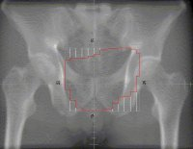
DRR –Digitally Reconstructed Radiograph
It is a simulation of a conventional 2D X-ray image, created from CT data. A conventional X-ray image/radiograph is single 2D view of total x-ray absorption through the body along a given axis. Two objects, say bones, in front of one another will overlap in the image. On the other hand, a 3D CT image gives a volumetric representation.
Earlier CT data sets were better thought of as set of 2D cross-sectional images. DRRs are created by summing CT intensities along a ray from each pixel to the x-ray source.

Slide 31
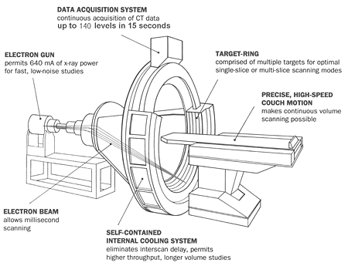
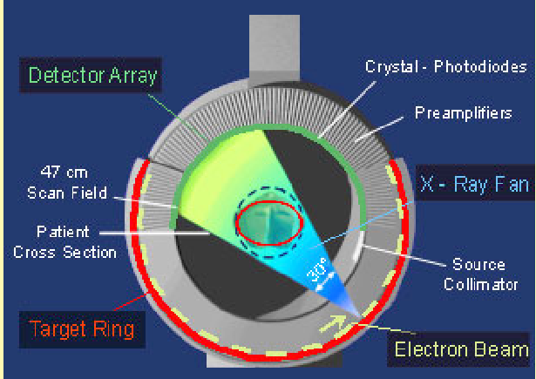
EBCT– Electron Beam C T

Slide 32
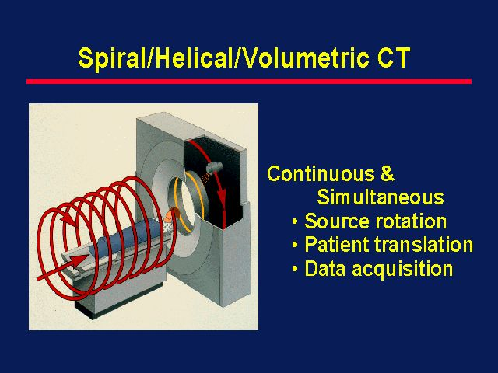

Slide 33
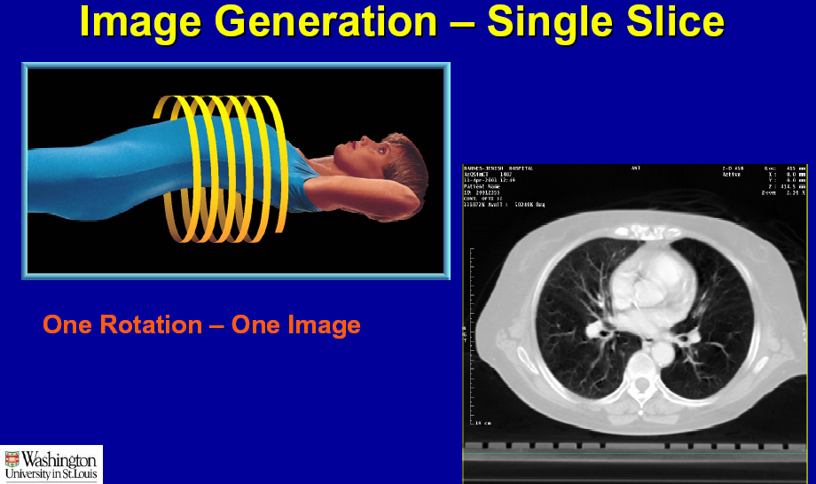


Slide 34






Hematoma
Kidney Stone
Fracture
Brain Tumer
Lung Cancer

Slide 35





3 D CT Scan
CT Virtual Endoscopy
CT Angiography

Slide 36
Diagnostic use of CT
Since its introduction in the 1970s, CT has become an important tool in medical imaging to supplement X-rays and medical ultrasonography.
Although it is still quite expensive, it is the gold standard in the diagnosis of a large number of different disease entities.
It has more recently begun to also be used for preventive medicine or screening for disease, for example CT colonography for patients with a high risk of colon cancer.
Drawback for the use of CT
Although, a number of institutions offer full-body scans for the general population, this practice remains controversial due to its lack of proven benefit, cost, radiation exposure, and the risk of finding ‘incidental’ abnormalities that may trigger additional investigations.

Slide 37



M R I Machine
MAGNET
RF COILS
PATIENT’S TABLE
RF SHIELDING
COMPUTER
MONITOR
MAGNETIC RESONANCE IMAGING IS A MEDICAL DIAGNOSTIC TECHNIQUE THAT COMBINES STRONG MAGNETIC FIELD, RADIOWAVES AND COMPUTER TECHNOLOGY TO CREATE IMAGES OF BODY USING PRINCIPLES OF NUCLEAR MAGNETIC RESONANCE

Slide 38
1) TO CREATE A STEADY STATE WITHIN BODY BY PLACING IT IN STEADY MAGNETIC FIELD THAT IS 30,000 TIMES STRONGER THAN EARTH’S MAGNETIC FIELD
2) THEN MRI STIMULATES THE BODY WITH RADIO-WAVES TO CHANGE THE STEADY STATE ORIENTATION OF PROTONS
3) IT THEN STOPS THE RADIO-WAVES AND ‘LISTENS’ TO BODIES ELECTROMAGNETIC TRANSMISSION AT SELECTED FREQUENCY
4) TRANSMITTED SIGNALS ARE USED TO CONSTRUCT GREY SCALE IMAGE OF BODY USING PRINCIPLES SIMILAR TO CT SCAN

Slide 39
MEDICAL HAZARDS AND SAFETY MEASURES
Does not involve ionising radiation.
No acute ill-effects have been noted.
Pregnant women should not be exposed above 2.5T.
Exposure of staff should not exceed 0.2T in 24 hrs.
Patients with cardiac pace-maker can’t undergo MRI.
First trimester of pregnancy.
Implanted devices (cochlear implant, ECG monitors) may be affected.
Acoustic noise associated with fast switching magnetic fields.
Microwave heating may occur at higher frequencies. Compensated by vasodilatation. Hence avascular /less vascular organs like cornea and testes are at risk.

Slide 40
Other Hazards
Mechanical attraction of ferromagnetic objects like scissors, scalpels, fire fighting equipments, patient bed, O2 cylinders etc.
Aneurysm clips
Ferrous foreign bodies, especially near eye
Fringe field can affect certain watches, computer disc, credit cards and video displays

Slide 41
MRI of Head –for tumors, an aneurysm, bleeding, nerve injury and other problems such as damage caused by a stroke. It can also find problems of the eyes and optic nerves, ears and auditory nerves.
MRI of Chest heart, the valves, and coronary blood vessels for any damage in heart or lungs. Such MRI also can scan for breast or lung cancer.
MRI of blood vessels –blood vessels and the flow of blood through them, can find problems of arteries and veins such as aneurysm, a blocked vessel, or the torn lining of a blood vessel.
MRI of abdomen and pelvis – It can find problems in the organs and structures in the belly such as liver, gall bladder, pancreas, kidney and urinary bladder. It is used to find tumors, bleeding, infection and blockage. In women it can look at the uterus and ovaries whereas in men it looks at the prostate.
MRI of bones and joints – can check for problems of bones and joints, such as arthritis, problems with temporo-mandibular joint, bone marrow problems, bone tumors, cartilage problems, torn ligaments or tendons, or infection. It can also tell if a bone is broken when X-ray results are not clear. More commonly done than other tests to check the problems of joints and bones.
Spine MRI – can check the intervertebral discs and nerves of spine for conditions like spinal stenosis, disc bulges and spinal tumors.

Slide 42






MRI Contrast
Brain Tumer
Cerebral Tumer
Spinal cord

Slide 43






MRI outputs

Slide 44


Slide 45

CT AND MRI ARE VERY SENSITIVE BUT NOT SPECIFIC. HENCE PATIENTS TO BE TREATED AND NOT THE IMAGES.

Slide 46
Biosensors
The revolution of nanotechnology in molecular biology gives an
opportunity to detect and manipulate atoms and molecules at the
molecular and cellular level.
Definition of biosensor
History
Types of biosensors
Working Principle and examples of biosensors
Application Areas and Current Research
Market for biosensors
References : Books, research articles and web sources

Slide 47
definition ..
A biosensor – a device that detects, records, converts, processes & transmits information regarding physiological change / process.
It is a device for the detection of an analyte.
It combines a biological component to an physicochemical detector component.
It is an analytical device which converts a biological response → an electrical signal
Biosensors are powerful tools aimed at providing selective identification of toxic chemical compounds at ultra trace levels in industrial products, chemical substances, environmental samples (e.g., air, soil, and water) or biological systems (e.g., bacteria, virus, or tissue components) for biomedical diagnosis.

Slide 48
1916 First report on the immobilization of proteins: adsorption of invertase on activated charcoal.
1956 Invention of the first oxygen electrode [Leland Clark]
1962 First description of a biosensor: an amperometric enzyme electrode for glucose. [Leland Clark, New York Academy of Sciences Symposium]
1969 First potentiometric biosensor: urease immobilized on an ammonia electrode to detect urea. [Guilbault and Montalvo]
1970 Invention of the Ion-Selective Field-Effect Transistor (ISFET).
1972/5 First commercial biosensor: Yellow Springs Instruments glucose biosensor.
1976 First bedside artificial pancreas [Clemens et al.]
1980 First fiber optic pH sensor for in vivo blood gases.
1982 First fiber optic-based biosensor for glucose
1983 First surface plasmon resonance (SPR) immunosensor.
1987 Launch of the blood glucose biosensor[ MediSense]

Slide 49
a successful biosensor must possess ..
It must be highly specific for the purpose of analysis.
Stable under normal storage conditions except colorimetric enzyme strips, dipsticks.
Stable over a large number of assays. (i.e. much greater than 100)
Reaction independent of pH, temperature, stirring to allow analysis of sample with minimal pre-treatment.
If the reaction involves cofactors or coenzymes these should, preferably, also be co-immobilized with the enzyme.

Slide 50
a successful biosensor must possess ..
The response should be accurate, precise, reproducible and linear over the useful analytical range, without dilution or concentration
It should also be free from electrical noise.
For invasive monitoring in clinical situations, the probe must be tiny and biocompatible, having no toxic or antigenic effects.
If it is to be used in fermenters, it should be sterilizable & should not be prone to fouling or proteolysis.
The complete biosensor should be cheap, small, portable and capable of being used by semi-skilled operators.

Slide 51
Parts of a Biosensor
a) The sensitive biological component (e.g. tissue, organelles microorganisms, cell receptors, enzymes, antibodies, nucleic acids, etc, a biologically derived material or biomimic) The sensitive elements can be created by biological engineering.
b) The transducer or the detector element (works in a physicochemical way; optical, piezoelectric, electrochemical, etc.) that transforms the signal resulting from the interaction of the analyte with the biological element into another signal (i.e., transducers) that can be more easily measured and quantified;
c) Associated electronics or signal processors that is primarily responsible for the display of the results in a user-friendly way.

Slide 52



Slide 53

Parts of a Biosensor
(a) the biocatalyst converts the substrate to product
(b) the transducer which converts the reaction to an electrical signal
(c) the amplifier,
(d) the processor
(e) the display

Slide 54
Working of a Biosensor ..
1. Analyte diffusion from the solution to biosensor surface. e.g. enzyme, antibody, organelle, hormone, nucleic acid or cell)
2. Specific reaction between the analyte & biological component
3. Due to this, change in physicochemical properties (e.g. optical, electronic) of the transducer surface.
4. The change measured & converted to an electrical signal.
5. The signal amplified, processed & displayed in an user friendly way.

Slide 55


Single-use biosensors
Multi-well plates
96/384 well
Microarray slides
Microfluidic chips
Instrumentation
General-use Plate Reader
High performance Imager

Slide 56


Slide 57
Types of biosensors ..
A] Thermometric –
Calorimetric --
Biological component ---- enzyme
Enzyme + Analyte ---- heat production
Change in temp. interpreted in terms of analyte conc.
Biosensor detects temp. difference of o.ooo1˚C
B] Electrochemical –
1. Potentiometric –
Biological component ---- enzyme
Enzyme catalysed reaction ---- H ⁺ production
Biosensor with ion-selective electrode ---- converts
biological reaction → electronic signal

Slide 58
2. Amperometric –
Biological component ---- enzyme
Redox reaction ---- causes electron movement
Biosensor detects the current( which is proportional to substrate concentration)
3. Conductimetric –
Biological component ---- enzyme
Biosensor detects electrical conductivity produced due to changes in ionic conc.

Slide 59
C] Optical –
Biological component ---- enzyme, antibody, DNA, RNA
Enzyme – catalytic reaction; DNA, RNA– affinity reaction
Biosensor – detects change in / absorbance of fluorescence
D] Acoustic / Piezoelectric –
Biological component ---- antibody bound to a crystal surface
Analyte + Antibody ---- change in resonance frequency of the crystal
Biosensor detects change in mechanical force / mass on it’s surface

Slide 60
E] Whole cell ---
Use live / dead microorganisms
Cheaper with longer half life
Less sensitive to pH, temp. variations than enzymes.
Specificity, sensitivity lower than enzymes
F] Immunobiosensors ---
Immunological specificity along with potentiometric / amperometric measurements
Widely used to detect and measure biological or chemical substances in various fields like healthcare, food safety, and environmental monitoring.

Slide 61
nanotechnology..
Control of matter on molecular or cellular scale. Generally it deals with structures < 100 nm
Nanotechnology uses two approaches:
Bottom up : material & devices are constructed from molecular components which assembles themselves chemically with the principles of molecular recognition
Top Down: Nano objects are constructed from larger entities without atomic level control
Nano bio sensor development: Nanotubes , nanoprobes

Slide 62



nanowire field effect nanobiosensors (FET) ..
Sensing Element
Semiconductor channel (nanowire) of the transistor.
The semiconductor channel is fabricated using nanomaterials such
a carbon nanotubes, metal oxide nanowires or Si nanowires.
Very high surface to volume radio and very large portion of the atoms are located on the surface. Extremely sensitive to environment

Slide 63
optical nanobiosensor ..
A sensor that uses light to detect the effect of a chemical on a biological system. [Kopelman et al.]
The small size of the optical fibers allow sensing intracelular intercelular physiological and biological parameter in micro- environment.
Two kind of fabrication methods for optical fiber tips;
1) Heat and Pull Method
2) Chemical Etching

Slide 64



photonic crystal biosensor ..
Reflected wavelength is “tuned” by adsorption of molecules on the PC
250 nm
TiO₂
TiO₂ (high index)
Water
1D
Plastic (low index)
Reflected light
Single color
White light
All colors
2D
Reflectivity
Light
bulb
Wavelength

Slide 65


how it works .. ?
“PWV”
Reflected color changes due to binding/removal of molecules or cells on the surface
Measure wavelength changes as small as 0.5 picometer

Slide 66
applications ..
A] In Medicine & Health : Quantitative estimation of glucose, cholesterol, urea, CO2, O2, toxic compounds in body fluids.
B] In Industry : Fermentation products, stored foods.
C] In pollution control : Pesticide concentration, BOD measurement, pollutants, mutagens
D] In Military & security : Explosive detection
E] In Border control : Narcotics, explosives detection by checking containers, trucks, cars in exposed environment; by screening of posts at air ports & ports in limited time.
F] In Correctional & Police authorities : Investigating prison cells, visitor screening, testing inmates for narcotic abuse.

Slide 67
applications ..
Glucose monitoring in diabetic patients : historical market driver
Other medical health related targets
Environmental applications e.g. the detection of pesticides and
river water contaminants
Remote sensing of airborne bacteria e.g. in counter-bioterrorist
activities
Detection of pathogens
Determining levels of toxic substances before and after
bioremediation
Detection and determining of organophosphate

Slide 68
applications ..
Routine analytical measurement of folic acid, biotin, vitamin
B12 and pantothenic acid as an alternative to microbiological
assay
Determination of drug residues in food, such as antibiotics
and growth promoters, particularly meat and honey.
Drug discovery and evaluation of biological activity of new
compounds.
Protein engineering in biosensors
Detection of toxic metabolites such as mycotoxins
Mobile equipment for drug & explosive detection – for investigating prison cells, visitor screening & testing inmates
Screening of post by an easy swipe on wrapping for narcotics & explosives, also for screening at air ports & naval ports.

Slide 69
cancer monitoring ..
Nanobiosensors play a very important role for early cancer detection in body fluids.
The sensor is coated with a cancer-specific antibody or other bio-recognition ligands. The capture of a cancer cell or a target protein yields electrical, optical or mechanical signal for detection.
Identification of Biomarkers
Validation of Cancer Biomarkers
Cancer Biomarkers
Ligands / Probes Developments
Cancer Diagnostics Biosensor ← Detector
Point of Care Cancer Diagnostics

Slide 70
detection of drugs & explosives ..
At air port biosensors can be effectively used to screen people, baggage, cargo, buildings, vehicles, aircraft
Advantages: unambiguous & quicker
highly sensitive & specific,
operationally reliable & effective
detect at very low concentrations
Successfully used in TNT & landmine sensing

Slide 71

how it works .. ?

Slide 72
sensing narcotics ..
Identification of narcotic intake becomes challenge for the forensic studies and legally significant
Advantages: the hygienic sweat or oral fluid sampling results are acceptable for judiciary process
superior cost ratios without increase of personnel
Successfully used in rehabilitation camps

Slide 73

market for biosensors ..
poorly explored
Estimated market about £12,000,000,000
Current use < 0.1%
60 % in health care
Wide and multidisciplinary R & D is required

Slide 74
web results on the topic ..
Search Engine: Google
About 7,00,00,000 results (0.28 seconds as on today)
About 2,760,000 pages (as on March 05, 2013)
Important sites to visit:
Wikipedia: http://en.wikipedia.org/wiki/Biosensor
Applications: http://www.biosensor.se/

Slide 75
blood glucose biosensor ..
Enzyme - Glucose oxidase immobilized in polyacrylamide gel around platinum oxygen electrode separated by a teflon membrane. From the top it is covered by a cellulose acetate membrane.
Reaction: Glucose solution allows to pass through a membrane reacts with enzyme and forms glutonic acid and hydrogen peroxide (oxidation reduction reaction) that reduces oxygen level which reflects in current.
Globally > 60 % population is facing diabatics

Slide 76




Slide 77
Application of AI
Surgery
Medical Imaging
Drug development
Health-care access
Data Collection
Disease diagnosis
Applications of AI

Slide 78


Slide 79


Slide 80



Slide 81
Genetic Engineering …
Recombinant DNA Technology, Genetic modification/manipulation (GM) and Gene splicing
Isolation of the gene
Enzymatic cleavage
Cloning a vector to form recombinant DNA
Transformation of a host cell
Identification of transformed cells (with rDNA) and their selection from non transformants
Amplification of rDNA to get multiple copies in a cell
Cell multiplication

Slide 82
Type I EcoB, EcoK | Recognition site for type I enzyme is 15 bp long and cleavage site 1000 bp away; the enzyme has restrictive subunit, modification subunit and specificity subunit; requires Mg⁺⁺, S-adenosyl methionine and ATP as cofactors
Type II EcoR1/R2 Hae III BamH1 | The length of recognition site for type II enzyme varies from 4/5/6/8 or more bp long and cleavage site 1000 bp away; the enzyme has restrictive subunit, modification subunit and specificity subunit; more stable and requires Mg⁺⁺ as cofactors
Type III MboII FokI | Made up of 2 subunits for recognition and cleavage; requires ATP for energy and Mg as co factor; recognition site is non palliondromic and cleavage site 25-27 bp away
Vectors : Plasmids / Bacteriophage / BAC / YAC / Shuttles

